Slide 1
Internal Hardware Device
By:Yash Shah

Slide 2
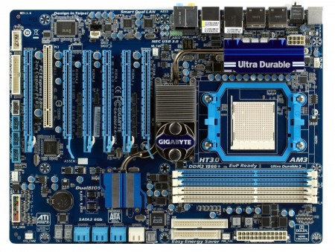
Mother Board
A printed circuit board containing the principal components of a computer or other device, with connectors into which other circuit boards can be slotted.

Slide 3
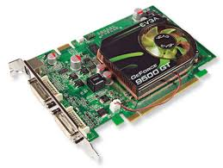
Graphics Card
A printed circuit board that controls the output to a display screen.

Slide 4
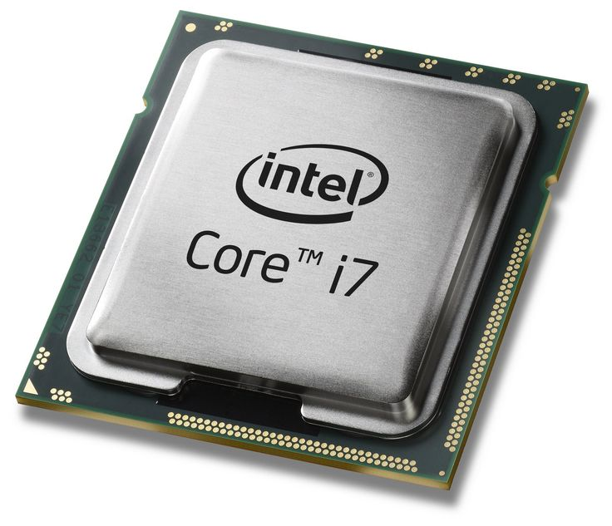
Centeral processing unit
The part of a computer in which operations are controlled and executed.

Slide 5
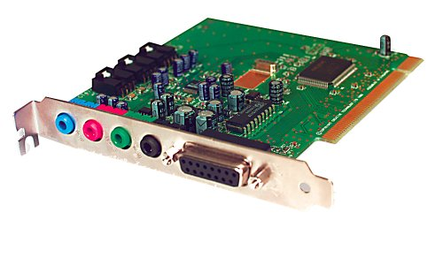
Sound Card
A device that can be slotted into a computer to allow the use of audio components for multimedia applications.

Slide 6
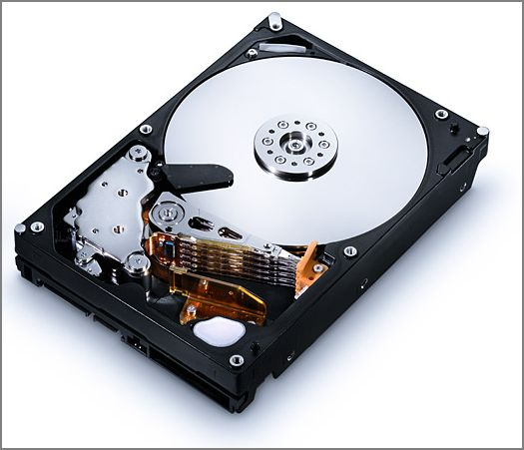
Hard Disk Drive
A hard disk drive (HDD), hard disk, hard drive or fixed disk is a data storage device that uses magneticstorage to store and retrieve digital information using one or more rigid rapidly rotating disks (platters) coated with magnetic material.

Slide 7
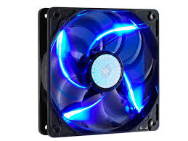
Fan
A computer fan is any fan inside, or attached to, acomputer case used for active cooling, and may refer to fans that draw cooler air into the case from the outside, expel warm air from inside, or move air across a heat sink to cool a particular component.

Slide 8
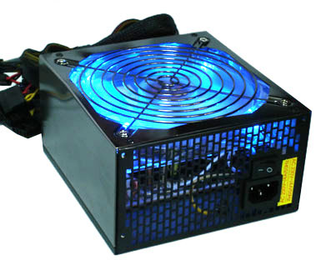
Power Supply
A power supply unit (or PSU) converts mains AC to low-voltage regulated DC power for the internal components of a computer. Modern personalcomputers universally use switched-mode power supplies. Some power supplies have a manual switch for selecting input voltage, while others automatically adapt to the mains voltage.

Slide 9
External Hardware Devices

Slide 10
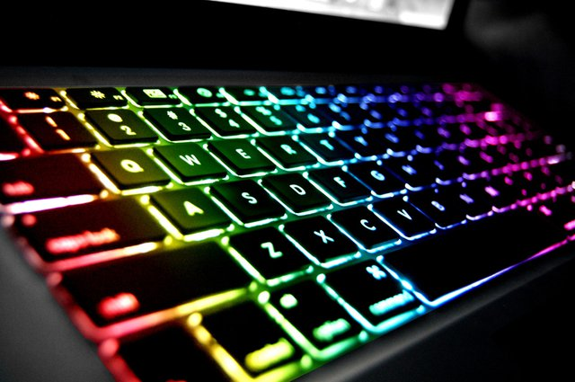
KeyBoard
a panel of keys that operate a computer or typewriter.

Slide 11
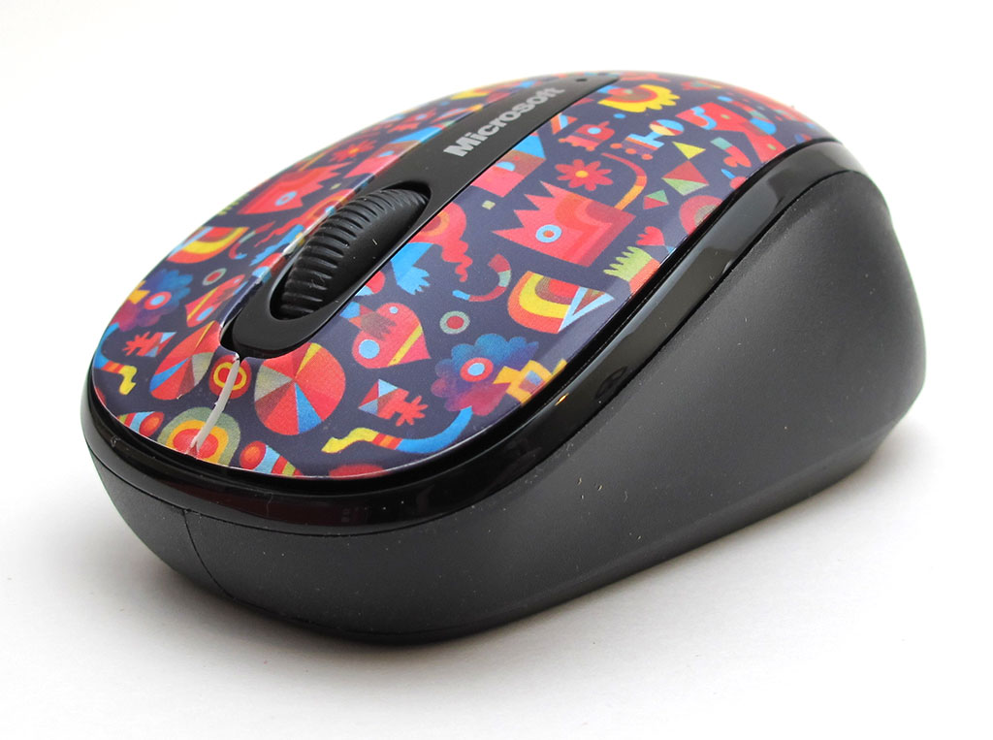
Mouse
use a mouse to move a cursor on a computer screen.

Slide 12

Microphone
A device containing a transducer for converting sound waves into electrical signals that can then be amplified, transmitted, and output through a speaker. See also speaker and transducer. ... A device that converts sound waves into analogous electrical waves.

Slide 13
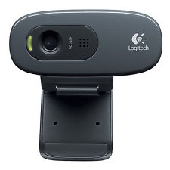
WebCam
A webcam is a video camera that feeds or streams its image in real time to or through a computer to a computer network. When "captured" by the computer, the video stream may be saved, viewed or sent on to other networks via systems such as the internet, and emailed as an attachment.

Slide 14
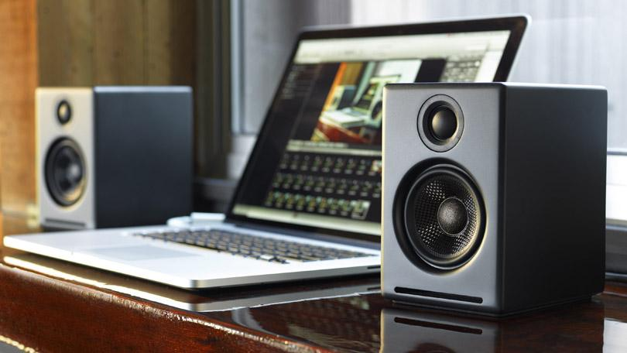
Speakers
They receive audio input from the computer's sound card and produce audio output in the form of sound waves. Most computer speakers are active speakers, meaning they have an internal amplifier which allows you to increase the volume, or amplitude, of the sound

Slide 15
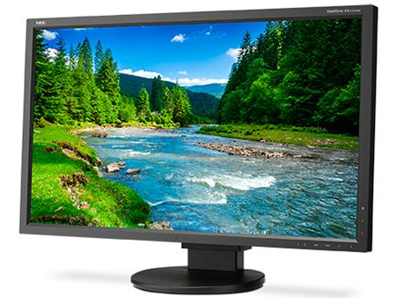
Monitor
A computer monitor is an electronic device that shows pictures for computers. Monitors often look similar to televisions. The main difference between a monitor and a television is that a monitor does not have a television tuner to change channels. Monitors often have higher display resolution than televisions.

Slide 16
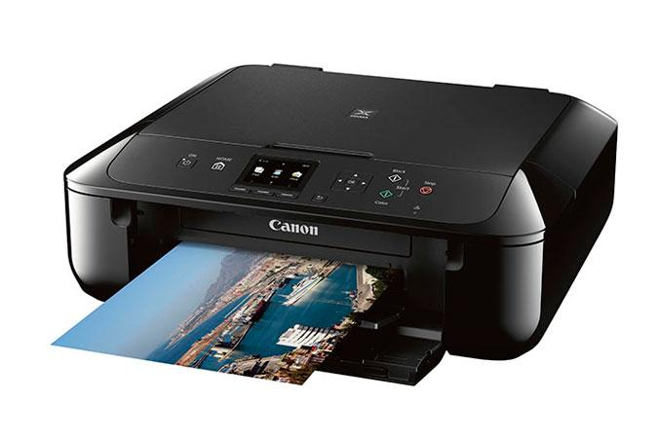
Printer
A printer is a device that accepts text and graphic output from a computer and transfers the information to paper, usually to standard size sheets of paper. Printersvary in size, speed, sophistication, and cost. In general, more expensive printers are used for higher-resolution color printing.

Slide 17
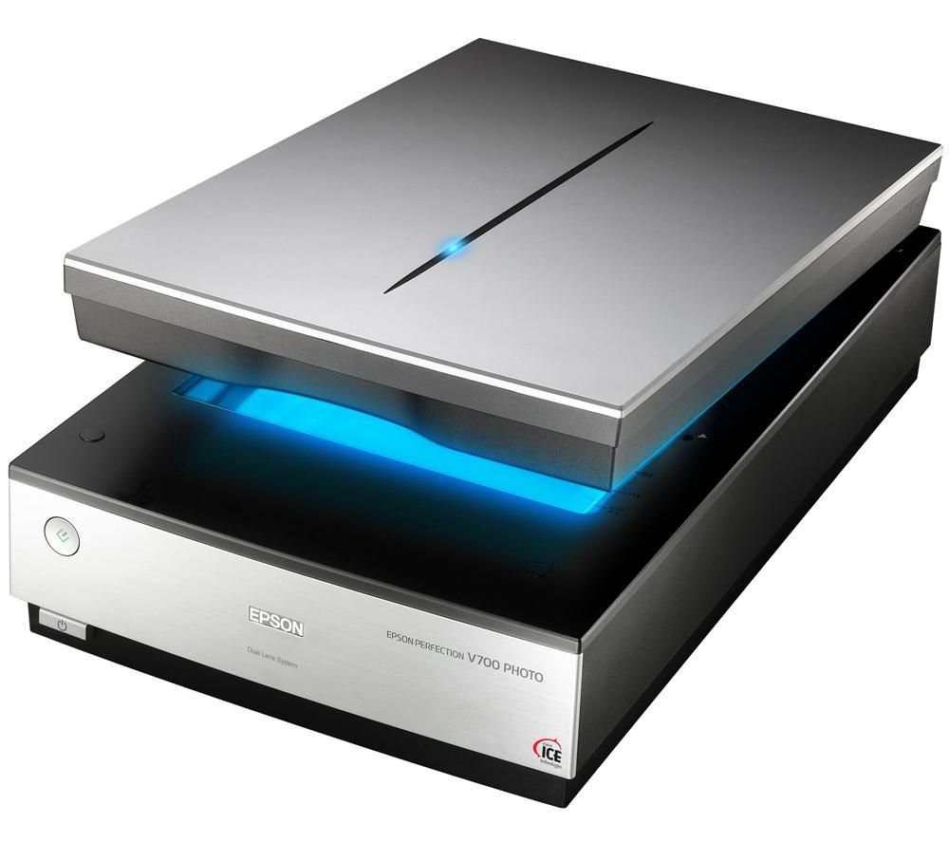
Scanner
A scanner is a device that captures images from photographic prints, posters, magazine pages, and similar sources for computer editing and display. Scannerscome in hand-held, feed-in, and flatbed types and for scanning black-and-white only, or color.

Slide 18
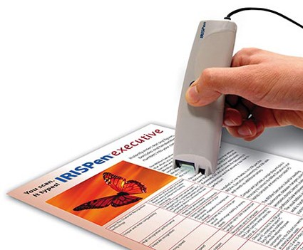
OCR
OCR (optical character recognition) is the recognition of printed or written text characters by a computer. This involves photoscanning of the text character-by-character, analysis of the scanned-in image, and then translation of the character image into character codes, such as ASCII, commonly used in data processing.

Slide 19
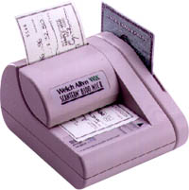
Micr
Short for Magnetic-Ink Character Recognition, MICR is a font capable of recognition using magnetically charged ink. Computers equipped with the right hardware and software can print or read the character printed in such ink. MICR font is commonly used to print checks, deposit slips, mortgage coupons, etc.

Slide 20
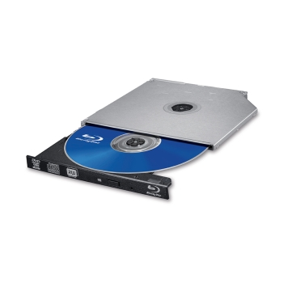
Blu-Ray Disk Drive
Blu-ray. Blu-ray is an optical disc format such as CD and DVD. It was developed for recording and playing back high-definition (HD) video and for storing large amounts of data.

Slide 21
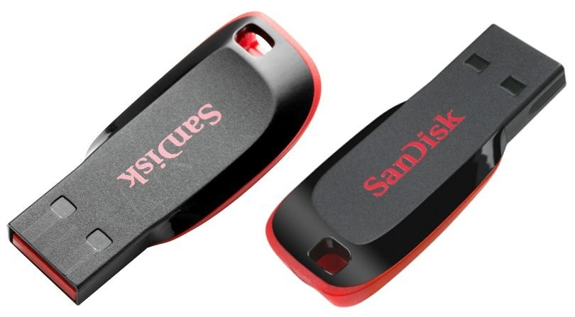
Pen Drive
A pen drive being inserted into a USB port. Licensed from iStockPhoto. noun. The definition of a pen drive is small storage device shaped like a pen with built-in data storage that connects to a computer by a USB port. An example of a pen drive is apen with a hidden USB port for saving data.

Slide 22
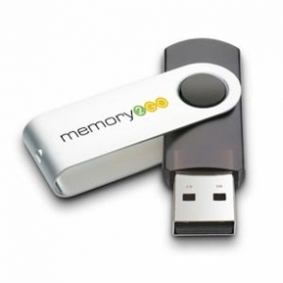
Memory Stick
USB memory sticks, also called pen drives or flash drives, are becoming more and more popular for the temporary storage and transfer of large amounts of electronic data. They should not be used as main data storage or to make permanent backups.

Slide 23
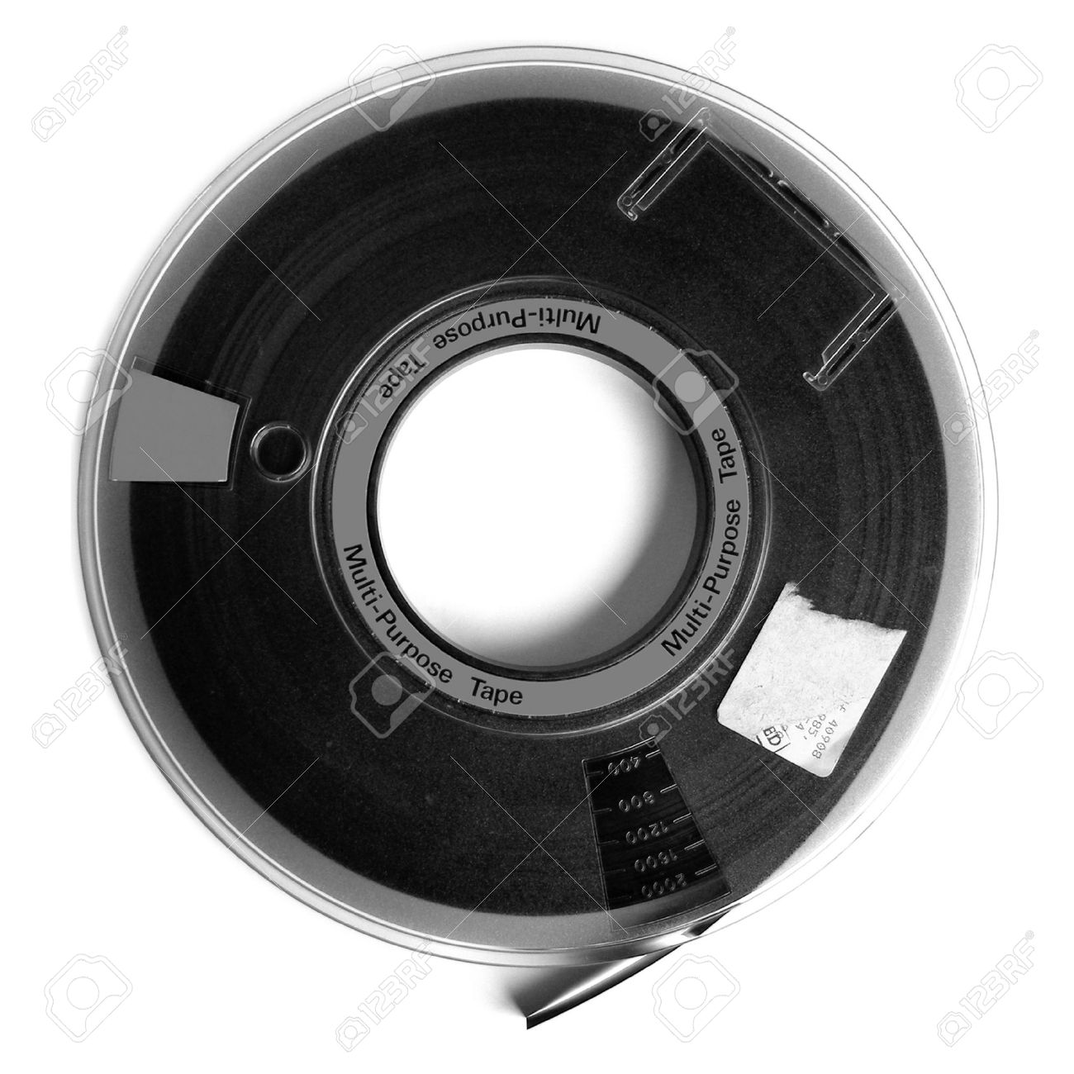
Magnetic Tape Drive
Magnetic tape is a medium for magnetic recording, made of a thin, magnetizable coating on a long, narrow strip of plastic film. It was developed in Germany, based on magnetic wire recording. ... A device that stores computer data on magnetic tape is a tapedrive (tape unit, streamer).

